Slide 1
Module M – Background and Responses to Sexual Abuse
Primarily for Dioceses

Slide 2
Background and Responses to Sexual Abuse of Minors by Catholic Priests in the United States

Slide 3
Main Sources of Data
Reports presented to the United States Conference of Catholic Bishops by the John Jay College Research Team, The City University of New York*
The Causes and Context of Sexual Abuse of Minors by Catholic Priests in the United States, 1950-2010, March, 2011
The Nature and Scope of Sexual Abuse of Minors by Catholic Priests and Deacons in the United States, 1950-2002, February 2004
* The two reports are based on data supplied by 97 percent of U.S. archdioceses and dioceses on all clergy accused of sexual abuse of minors

Slide 4
Timeframes of First Abuse
Most priest abusers were in seminary before the 1960s, but offended after the 1960s
Among priests who engaged in abusive behavior, the more recently they were ordained the more quickly after ordination did they abuse

Slide 5
Historical Changes in Abusers
Year of % of All Average Age Average Time
Ordination Abusers at 1st Incident to 1st Abuse
1940s 40% 44 17 years
1950s 39 12 years
1960s 25% 35 8 years
1970s 20% 33 5 years
1980s 10% 35 3 years

Slide 6
The Rise and Fall of Abuse
Total credible accusations through 2010 is 14,076 (14,670 by 2011; of the additional 594, a total of 23 were accusations of abuse happening in 2011, 21 of whom were made against diocesan priests and 2 against religious priests)
Although widely believed to be a significant ongoing problem, most abuse occurred between 1960 and 1984 (90.5%); after that year the numbers dropped substantially and remain low
From 1985 to the present the proportion is 9.5%

Slide 7
National Patterns of Social Change
During the period under study, the U. S. experienced significant and widespread social change that encompassed:
Steady increases in attitudes and behaviors associated with increased individualism between the 1960s and the 1980s – resulting in positive increases on creativity and productivity, and negative results associated with deviance and harm to others
A sharp reaction in the 1980s and 1990s to increases in crime and an increased understanding of the harms of teenage parenthood, domestic violence, and abuse of children, followed by decreases in these behaviors

Slide 8
Distribution of Abuse – Incidence (Count of abuse incidents, JJC & CARA, 1950-2002, 2004-2008)

Slide 9
Priests Who Have Allegations of Sexual Abuse against Them
The majority of priests with allegations of abuse from 1950-2002 were ordained between the 1950s and 1970s
The majority of those with allegations against them are diocesan priests
Religious priests have slightly more than half as many allegations; fewer religious have multiple allegations or “severe” offenses

Slide 10
Decline in Incidence
The peak numbers of abuse cases precede the Gauthe scandal and actions by the Church; they match other indications of social stress on those in Catholic ministry, e.g., many resignations took place
The 1970s is the decade of greatest incidence and also the decade of universal statutory change
After 1985, publicity and church action increase the rate of change and numbers decline rapidly
The influence of statutory change is difficult to disaggregate from social forces and growing public understanding of domestic abuse.

Slide 11
Mainstream Seminary Formation
Major Seminary Education
Diocesan priests who would later abuse were trained predominantly in major U.S. theological seminaries
Almost all major seminaries graduated priests who would later abuse minors, but the numbers varied significantly from one seminary to another
Minor Seminaries
Priests who began in minor seminary are not more likely to later abuse
Seminary Program Changes
Administrators and faculty evaluated seminary education over this period of time (1980s to the present) and introduced significant changes in programs of human formation

Slide 12
Sexual Abuse and Civil Authorities
Until recently few incidents of abuse by priests were reported to the police
One-third of those priests were charged with a crime
Only 3% of all priests with allegations served prison sentences

Slide 13
National Patterns of Accusations: Extent of the Problem
Most accusations of priests abusing children were unknown to civil authorities or church leaders before 2002
Between 1950 and 1985, the total number of incidents of sexual abuse of children reported to Catholic dioceses was 810
The total reported (by 2010) to have occurred between those years, 1950 and 1985, exceeds 11,000 (11,719). Reports came long after the abuse had occurred.
The total number of cases reported from 1950 through 2011 is 16,330.

Slide 14
Reports and Response, mid-1990s
Total Reports, 1990 to 1998 = 3,754
Almost all dioceses received reports in this period
- 75% of incidents reported by victim or attorney
- 60% reported to diocese, 9% by legal filing
- 9% reported within two years of the incident, or less
- 50% reported 20 years or more after the incident
Reports of abuse are now being made by adults many of whom are represented by lawyers and who are reporting abuse that took place many years earlier.

Slide 15
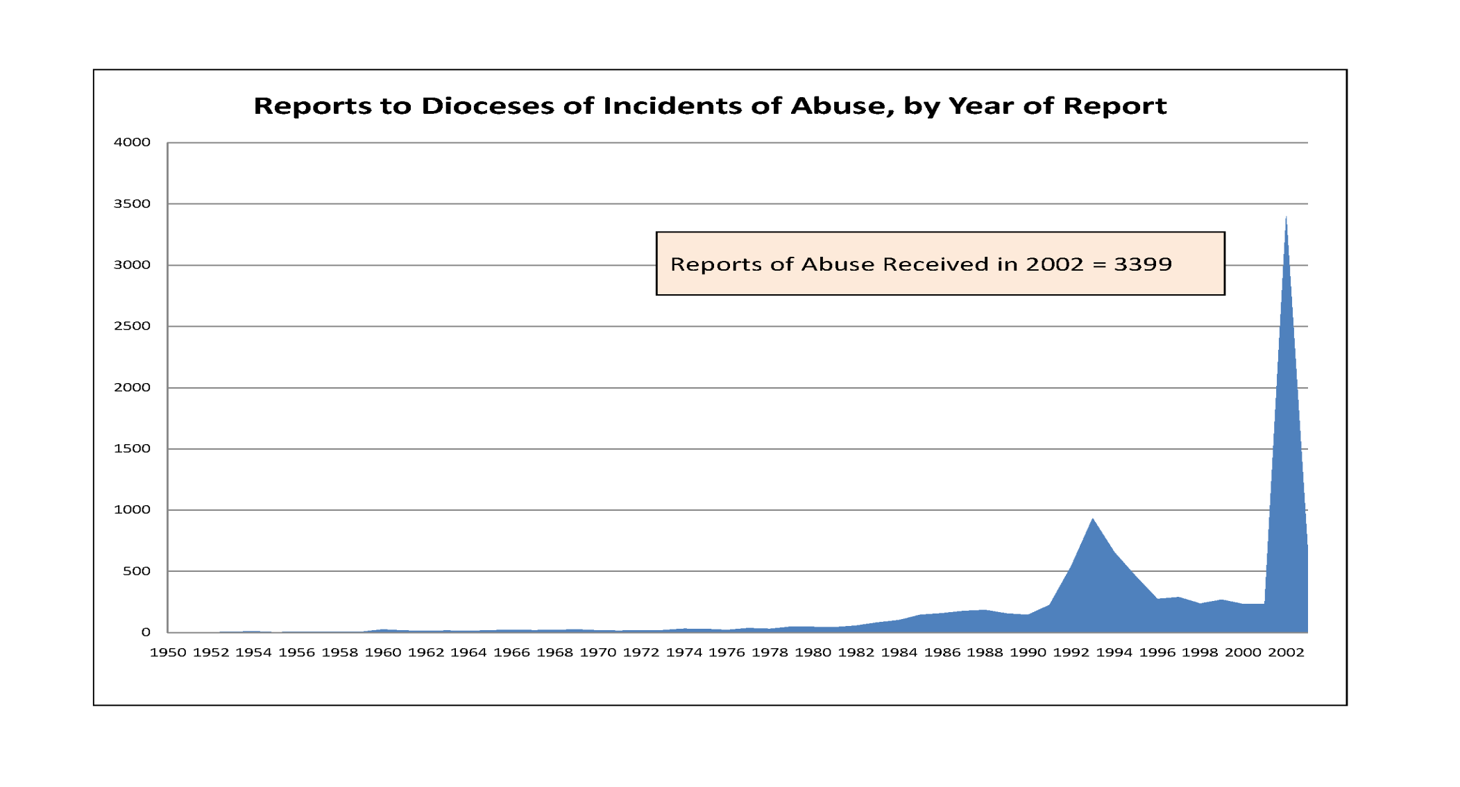
Nature and Scope: Reports of Abuse, by Year Reported

Slide 16
Development of the Five Principles
1985 – 1995: The issue of sexual abuse is discussed annually at meetings of the bishops; expert presentations given
Leadership from Cardinal Bernardin, Archdiocese of Chicago, importance of lay review boards stressed
Work of the Ad Hoc Committee resulted in publication of Restoring Trust and other changes
Use of treatment continues, with extensive communication with treatment centers (surveys of treatment centers; reports to dioceses on priests referred for treatment provided)
Growing advocacy for victims from organized groups of those who had been abused; included priests who had been abused
Most dioceses had codified the Five Principles by mid-1990s; about 50% had review boards

Slide 17
“Five Principles” Adopted by the Bishops’ Conference
“Five Principles” to Guide the Response of Bishops (1992)
(1) Respond promptly to all allegations of abuse where there is reasonable belief that abuse has occurred;
(2) If such an allegation is supported by sufficient evidence, relieve the alleged offender promptly of his ministerial duties and refer him for appropriate medical evaluation and intervention;
(3) Comply with the obligations of civil law regarding reporting of the incident and cooperating with the investigation;
(4) Reach out to the victims and their families and communicate sincere commitment to their spiritual and emotional well-being; and
(5) Within the confines of respect for privacy of the individuals involved, deal as openly as possible with the members of the community

Slide 18
Problems with the Implementation of the Five Principles, 1990 - 2002
Diocesan leaders in many instances failed to meet with victims directly
Reports from family members did not result in any follow-up from the diocese
Priests were sent for treatment, then returned to service; parishes were not notified of the history of abuse
Communication took place with civil authorities only in the most severe cases of repeated abuse
Diocesan leaders who gave testimony under oath in civil cases denied the substance of the Five Principles
Focus was on outcomes for priests, but lacked recognition of responsibility for harm to victims

Slide 19
Diocesan Practices Changed Slowly
Diocesan failures during the pre-2002 period anticipated (predicted) the confusion and lapses of the post-2002 period
Lack of full implementation of the Five Principles in the mid-1990s led to a reluctance to be transparent about the actions taken in response to reports of abuse
Lack of understanding of the timing of abuse incidents (in the 1960s and 1970s) and reports of abuse (in the 1990s) complicated diocesan explanations
Understanding of the harm of abuse has come slowly
Change in practices has come slowly; delay was pronounced in large and influential dioceses

Slide 20
Understanding of Sexual Abuse by Church Leaders
By 1985 bishops knew that sexual abuse of minors by priests was a problem, but they did not understand the scope of it nor the impact on victims; 810 cases had been reported to dioceses by 1985, so the problem did not appear to be as widespread and sizeable as it was
The vast majority of cases were reported after 1995, and a third in the year 2002 alone; only after 2002 did most bishops become fully aware of the scale and scope of the problem

Slide 21
Church and Seminary Responses
Until 1992 church documents generally did not reflect the necessity of revising seminary formation to deal with reports of abusive sexual behavior by priests
Nonetheless, seminaries recognized the need for change and began to modify formation programs substantially by the late 1980s

Slide 22
Some Key Findings - 1
Priests with intimacy deficits and an absence of close personal relationships before and during seminary were more likely to abuse minors
Low self-esteem and social isolation are associated with child sexual abuse

Slide 23
Some Key Findings - 2
Abusive priests commonly created opportunities to be alone with minors, for example, in their rectory, during retreats and/or while on camping trips or travelling
These priests often integrated themselves into the families of victims and then sought occasions to be alone with the children or with one child

Slide 24
Some Key Findings - 3
No single “cause” of sexual abuse of minors by Catholic priests has been identified as a result of the John Jay research
Nonetheless, when individual priests abused minors, many organizational, psychological, and situational factors contributed to their susceptibility

Slide 25
Discussion Questions, 1
What reflections do you have about clerical sexual abuse in recent years?
What are some of the major concerns you have about the implications of sexual abuse at the diocesan level?
How can dioceses improve implementation of “The Five Principles”?
How can the response by those who must be accountable for preventing sexual abuse be improved?
What more needs to be done to ensure continued progress in understanding and acting on the problem of clerical sexual abuse?

Slide 26
Discussion Questions, 2
What lessons can be learned from the changes in patterns of abuse over time?
What precautions should be taken into account by dioceses when assessing possible “causes” or risk factors involved in sexual abuse?
What situational safeguards might be put in place to help prevent sexual abuse?
What other preventative measures are needed in the future?
Link to USCCB – http://www.usccb.org/issues-and-action/child-and-youth-protection/charter.cfm
M-26

Slide 27
Prepared by:
Sister Katarina Schuth, O.S.F., St. Paul Seminary School of Divinity, University of St. Thomas
Technical Associate: Catherine Slight
Consultants:
Dr. Karen Terry and Margaret Smith, John Jay College of Criminal Justice, authors of major studies on sexual abuse for the USCCB;
Dr. Mary Gautier, Center for Applied Research in the Apostolate
M-27

