Slide 1
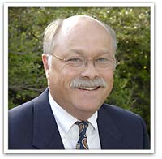
NFP Fact Checkers
Richard J. Fehring PhD
Mike Manhart PhD

Slide 2
Topics for Fact Checking
Evidenced-Based Medicine/Healthcare
Effectiveness for Avoiding pregnancy
Effectiveness for Achieving pregnancy
Effectiveness postpartum/breastfeeding
Effectiveness perimenopause
Effectiveness in atypical situations
Differences between NFP and contraception
Best NFP method? Too complicated?

Slide 3
Research Director & Chair

Slide 4
Evidence Based Medicine

Slide 5
Terms
Translation/Utilization CTSI https://ctsi.mcw.edu/
Evidenced based practice/health care/nursing/medicine
Evidenced based protocols/Clinical practice guidelines/reviews
Comparative Effectiveness Research (IOM-CER)
http://www.iom.edu/Reports/2009/ComparativeEffectivenessResearchPriorities.aspx
Patient Centered Outcomes Research Initiative (PCORI)
http://www.pcori.org/
Diffusion research/Scaling up research for poor/developing Countries:
http://www.nrsp.org.uk/6_2_2.aspx
Research into copyrighted intellectual property/patent (Technology Trans Offices)
Research into small business

Slide 6
Evidence Based Medicine - Why
Much of health care practice lacks a strong evidence base.
Methods to increase use of evidence – translational, utilization protocols, etc.
One of the best and most useful has been the development of systematic research reviews.

Slide 7
Systematic Research Reviews
Summaries of past research in which the reviewers extract, analyze and integrate findings from peer reviewed scientific studies and produce conclusions that can aid practice.
Systematic reviews are based on a wide and exhaustive search of existing studies.

Slide 8
Sources of Evidence
Blinded peer reviewed scientific journals
Scientific search engines (i.e., NLM; Medical Index, Web of Science, PsyAbsts)
Example (The Linacre Quarterly or NCBC Quarterly)
Impact factors – highest (Human Reprod: Fertil/Steril)
Trials need to be registered at clinicaltrials.gov
Need to follow standards e.g., CONSORT;STROBE, etc.
Need to provide evidence for external Institutional Review Boards (IRBs) for ethics.
Yearly – ethics approval – amendments

Slide 9
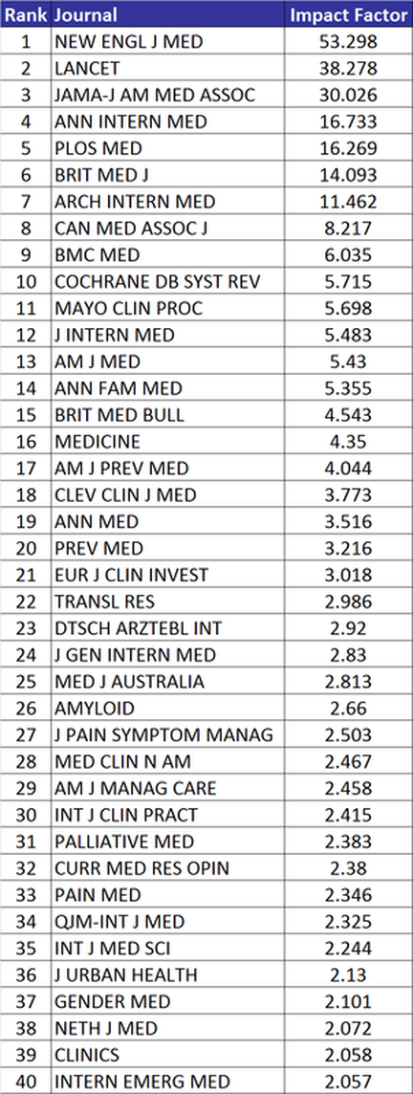
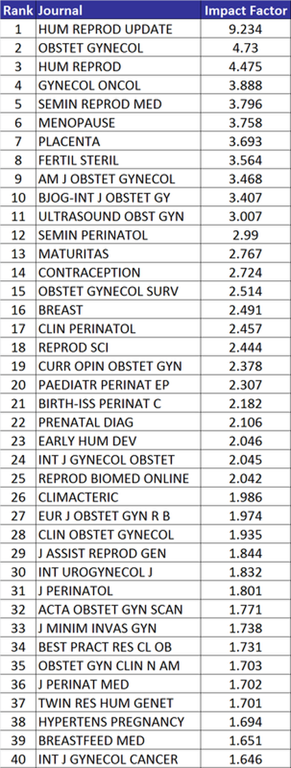

Slide 10
Brazilian Rock Star – Impact/scaling-up/diffusion/e-Libraries

Slide 11
Steps of Research Reviews
Selecting topic important to practice,
Conducting an exhaustive search of evidence,
Establishing criteria for selecting best evidence,
Making a table of the studies in the review,
Analyzing the evidence, and
Providing a summary and conclusion.

Slide 12
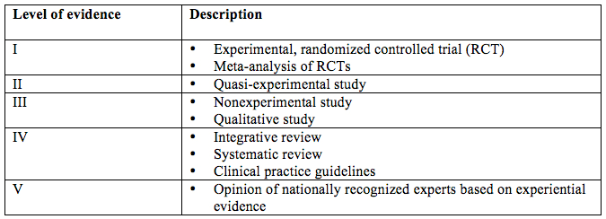
Levels of Research Evidence
Internal Validity: Controlling confounding factors that might explain the results.

Slide 13
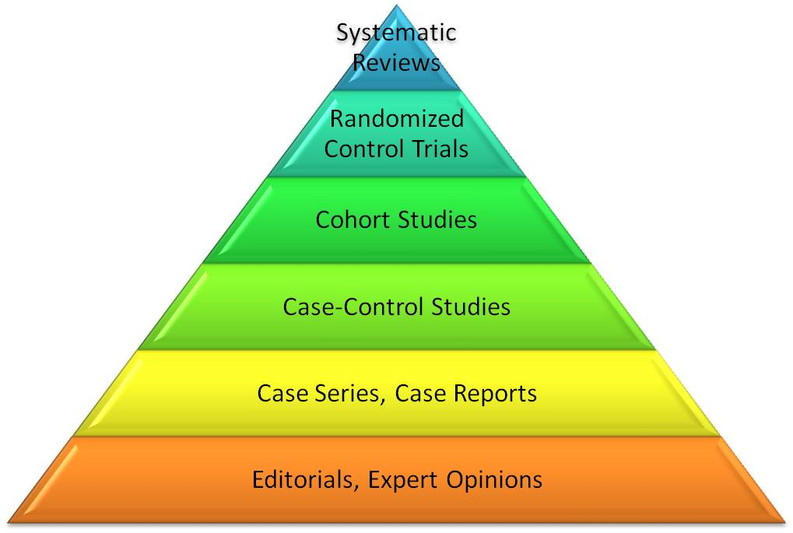
Levels of Research Evidence

Slide 14
Grading of Evidence A-F
A = strong scientific evidence
B = good scientific evidence
C = mixed or conflicting evidence
D = strong negative evidence
F = lack of evidence

Slide 15
Clinical Trials
Single arm versus randomized comparison
Avistan example
Phase 3
Generalizability – externally valid!
Are most NFP efficacy studies externally valid – probably NOT!

Slide 16
Comparative Effectiveness Research (CER)
Involves providing evidence for treatments, methods or approaches for managing major health concerns and conditions.
The purpose of CER is to identify what works best for which patients under what circumstances and is patient focused.
The Institute of Medicine (IOM) has delineated the 100 most significant areas that need better research and comparative evidence for treating or managing health problems (IOM 2009).

Slide 17
CER and NFP
In the top 25 list of the IOM’s CER is the effort to compare the effectiveness of innovative strategies for preventing unintended pregnancies.
Which method of NFP works best for which couples (for achieving or avoiding pregnancy) and under what circumstances is of interest to those health providers who provide or refer for a moral (and integrative) approach to family planning.

Slide 18
Cochrane Reviews
Archie Cochrane, PhD
Problems
Tamaflu
Metronixs
Bias of authors researchers
Ghost writers
http://www.cochrane.org/

Slide 19
Grimes Cochrane Review of NFP
Grimes et al. (2010), in a systematic review of fertility awareness-based methods for avoiding pregnancy, identified 3 randomized controlled trials that have been published:
Medina et al (1980), comparing the ovulation method to the symptothermal method in Colombia;
Wade et al (1981), comparing the ovulation method to the symptothermal method in Los Angeles;
and Kass-Annesse (1989), comparing use of a vaginal sponge with and without a calendar plus basal body temperature method.
http://summaries.cochrane.org/CD004860/family-planning-with-methods-based-on-fertility-awareness

Slide 20
Reviews of NFP Studies
Manhart, M. D., M.Duane, A. L. Lind, I. Sinai, and J. Golden-Tevald. 2013. Fertility awareness-based methods of family planning: A review of effectiveness for avoiding pregnancy using SORT. Osteopathic Family Physician 5: 2-8.
Smole, B. A., and C. M. Robinson. 2012. Natural family planning. American Family Physician 86: 924-928.

Slide 21
Effectiveness in Avoiding Pregnancy

Slide 22
Executive Director & Teacher
25 yr. career in Drug development-retired
28 yr. career NFP teaching couple

Slide 23
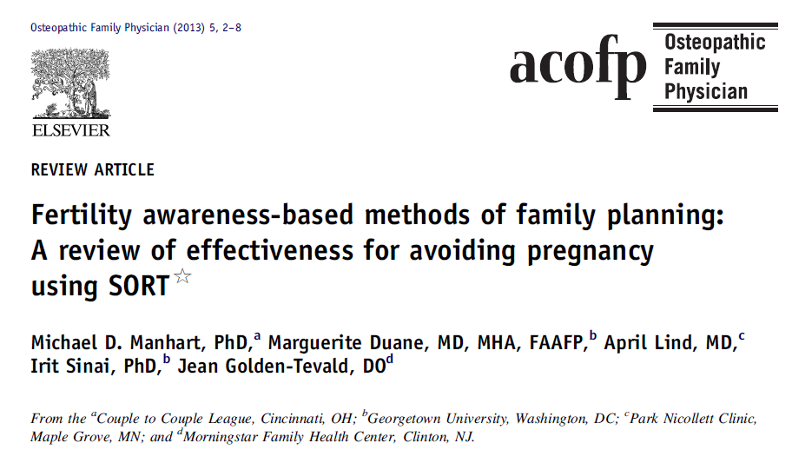
Recent Review

Slide 24
SORT- Strength of Recommendation Taxonomy
Developed for use by family medicine and primary care journals
Focus on patient centered outcomes
Framework to determine level of evidence for individual studies (evidence= 1,2,3)
Framework for Strength of Recommendation based on body of evidence (SOR= A,B,C)
Ebell, M.H., et. al. (2004) Am Fam. Physician 69:548-56

Slide 25
Level of Evidence for Single Study
Ebell, M.H., et. al. (2004) Am Fam. Physician 69:548-56

Slide 26
Defining a High quality FABM cohort clinical trial
Critical Criteria | Description | Points
Sexually Active | Only sexually active, fecund, women admitted | 4,2,0
Prospective | Data collected prospectively | 4,0
Size | Properly sized trial to address the research question | 4,2,0
Standardized counseling | FABM taught to participants using standardized counseling | 4,2,0,
No Learning phase | Follow-up starts immediately after method counseling | 4,0
Follow-up | Participants followed for at least one year of method use | 4,0
Survival Analysis | Pregnancy rates calculated using survival analysis/life tables | 4,0
Pregnancies Recorded | Procedures to ensure that all pregnancies are detected and recorded | 4,2,0
Prospective Preg. Intentions | Pregnancies recorded as intentional only if prospectively classified as intentional | 4,0
typical use | Analysis of typical use pregnancy rates includes all unintentional pregnancies, and all cycles of use | 4,0
correct use | Analysis includes all cycles in which the method was correctly used to avoid pregnancy, and exclude from the denominator cycles in which the method was not correctly used to avoid pregnancies | 4,0
IRB | IRB review to ensure rights of participants were respected | 4,0

Slide 27
Scope of review
All peer-reviewed publications from 1980
Rationale:
Sufficient time to have maximum # trials
Includes WHO Ovulation method publications
Approximately 150 citations identified
~80 reviewed in depth

Slide 28
FABM Evidence for Efficacy in Postponing Pregnancy
29 clinical trials
8,200 women
107,000 cycles
All major FABM- at least one study evidence level 1
Sounds like a lot but….

Slide 29
Clinical Data Submitted for a Single Drug Approval
10 separate efficacy studies
15,396 patients followed 1-10 years
20-30 publications per year from dataset post approval.

Slide 30
Key issues in NFP studies
Learning periods
High drop out/ lost to follow-up
Pearl rate analysis
Retrospective
Published without peer review
Inconsistency/lack of clarity on rules used across studies
Notes:
Example of inconsistency- Rice (1981) study STM used 5 countries each one had slightly different rule for determining fertile window so compromised on least common denominator to define (temp only for end of window, Calendar rule for beginning)

Slide 31
Best Evidence of FABM in postponing pregnancy
Method | 1yr. probability unintended pregnancy |  | SORT Evidence Level | Score | Citation
 | Correct use | Typical use
STM | 0.4% | 1.6% | 1 | 55 | Frank Hermann (2007)
 | 0.6% | 2.2% | 1 | 55 | Frank Herrmann (1997)
STM w/barrier | 0.6% | 2.0% | 1 | 55 | Frank Herrmann(2007)
 | 0.4% | 1.4% | 1 | 55 | Frank Herrmann (1997)
Creighton | 0.5% | -- | 1* | 43 | Hilgers (1998)
 | 0.14% | -- | 1* | 43 | Howard & Stanford (1999)
Billings | 3.2% | 22% | 2 | 52 (post hoc) | Trussell (1991)
 | 1.1% | 10.5% | 1 | 52 | Indian Med. Tsk Frc. (1996)
Marquette | 2.1% | 14.2% | 1 | 54 | Fehring (2007)
TDM | 3.5% | 13.7% | 1 | 56 | Arevalo (2004)
SDM | 4.7% | 12% | 1 | 56 | Arevalo (2002)

Slide 32
New Clinical Data
Randomized comparison of 2 internet-supported Marquette models
“Monitor alone” vs. “Mucus alone”
All charts recorded online
Total Pregnancies per 100 women over 12months
 | Monitor N=197 | Mucus N=164 | Stat. Diff.
Perfect use | 0 | 2.7 | N.S.
Typical use | 7 | 18.5 | Sig. dif.
# pregnant in 1st 3 mos. | 5 | 11
Fehring et al; Contraception 88(1):24 (2013)

Slide 33
Strength of Recommendation
Level A: (consistent quality evidence)
STM & STM+ barriers
Creighton - correct use only
Level B: (Inconsistent or limited evidence)
Billings
Marquette
SDM
TDM

Slide 34
Conclusions
Fertility Awareness Based Methods:
Robust evidence of effectiveness
As effective as hormonal contraceptives
More research needed
More than a means to prevent pregnancy
Family physicians well-trained to support

Slide 35
Evidence Grades for NFP
Grades
MDM RJF
A B
A B
C C
F F
Preventing pregnancy in reproductive aged women:
When methods used correctly
When methods used typically
Is there a difference between methods for typical use?
Is NFP as good as Oral contraceptives?

Slide 36
Effectiveness in Achieving Pregnancy

Slide 37
Gnoth, et al., (2003)
Time to pregnancy: Results of the German prospective study and impact on the management of infertility. Human Reproduction, 18(9), 1959-1966.
346 women who used STM to conceive. The couples timed their intercourse acts with the identification of peak fertility according to vulvar mucus sensations. The cumulative probabilities of conception were 38, 68, 81, 92% respectively at 1, 3, 6, and 12 months for the whole group.
NO evidence that these rates are better than random intercourse.

Slide 38
Other studies
Hilgers, et al., reported a study in which 49 of 50 couples (of normal fertility) achieved a pregnancy within 5 months by focusing intercourse on days of good quality cervical mucus.
Hilgers TW, Daly KD, Prebil AM, Hilgers SK. Cumulative pregnancy rates in patients with apparently normal fertility and fertility-focused intercourse, Journal of Reproductive Medicine. 1992:37:864-866.

Slide 39
Robinson JE, Waklin M, Elllis JE. Increased pregnancy rate with use of the Clearblue Easy Fertility Monitor. Fertility and Sterility, 2007;87(2):329-34.
1,000 women volunteers into two groups, one group of 500 received an EHFM, and the control group of 500 women volunteers were asked to do what they wished to achieve a pregnancy, including the use of pregnancy assist devices (e.g., ovulation test kits and basal body temperature).
The pregnancy rate during the first cycle was 15.2% (or 46 of 302) for the EHFM group and 7.8% (27 of 347) for the control group. The two cycle cumulative pregnancy rate was statistically higher for the EHFM at 22.7% compared with the control group at 14.4% (p=0.006).

Slide 40
Tiplady, S., Jones, G., and Campbell, M. et al., Home ovulation tests and stress in women trying to conceive: a randomized controlled trial. Human Reproduction, Advance Access published October 18, 2012.
Volunteer couples from the UK were randomized into either a group who were provided a digital urinary ovulation predictor kit based on detecting a rise from baseline in urine luteinizing hormone (LH) or a group of women who were advised to have frequent intercourse (every 2-3 days) and not use any self-observation fertility indicators. Of the 210 UK volunteer women/couples 115 were randomized into the digital LH kit group and 95 into the frequent intercourse group.
Although pregnancy rates were not the main question of the study, they did find 43% of the women in the digital LH group achieved pregnancy and 30% in the control group. The odds of achieving pregnancy with the digital LH test kit and timed intercourse was 59% greater compared to the control group.

Slide 41
Mu and Fehring (2013)
Purpose: To compare pregnancy rates when couples have intercourse on self-estimated high and peak fertile days and when they only have intercourse on low fertile days during the fertile window (FW).
124 couples who utilized our online charting websites to achieve pregnancy from January 2010 to November 2012. Participants used an electronic hormonal fertility monitor (EHFM) or self-observed cervical mucus or both to determine fertility during the estimated FW.
Results: The pregnancy rate was 87 per 100 women at 12 months when intercourse happened on high or peak days and 5 per 100 when intercourse occurred only on low days of the FW. Chi square analysis showed a greater proportion of pregnancies with intercourse on high and peak fertile days of the menstrual cycle (x² = 40.2, p < .001, df =1).
Accepted for publication in MCN: The American Journal of Maternal Child Nursing.

Slide 42
Summary
There is growing evidence to show that focused intercourse during the fertile time as estimated by self monitoring of natural biological markers of fertility will increase the pregnancy rate and decrease the time to pregnancy.
Two randomized trial comparing self-indicators of fertility to estimate the fertile phase and timed intercourse exists. The National Institute for Clinical Excellence (NICE) guidelines specifically state that use of focused intercourse is too stressful and no more effective than having intercourse 2-3 time per week.
The ASRM policy committee recommended that electronic or other devices that are designed to aid the couple in determining the optimal time of fertility may be useful for couples who have infrequent intercourse.

Slide 43
Evidence Grades for NFP
Achieving pregnancy in reproductive aged women
Grades
MDM RJF
B C

Slide 44
Effectiveness when used postpartum

Slide 45
Lactational Amenorrhea Method
1988 Bellagio Consensus
<2% probability of pregnancy if:
Fully, nearly fully breastfeeding
No bleeds
Baby < 6 months old
Confirmed in subsequent studies

Slide 46
LAM- WHO trial
4118 breastfeeding women, 7 countries
3443 completed study
85 total pregnancies
46 in B.F women not using contraception
WHO Task Force. Fertil. & Steril. 72(3):431 (1999)

Slide 47
LAM-WHO trial
Cumulative Pregnancy Rates using Various Definitions of End of Amenorrhea
 | Fully Breastfeeding women |  |  |  | Partially B.F.
Amenorrhea ending def. | HRP-confirmed | HRP-1st menses | Woman’s perception | Any 1st bleed | range
6 months | 1.2 | 0.9 | 0.9 | 1.0 | 0.7-0.8
12 months | 6.8 | 6.6 | 7.4 | 6.9 | 3.7-5.2
WHO Task Force. Fertil. & Steril. 72(3):431 (1999)
Among breastfeeding women w/o contraception expect:
<2% probability pregnancy up to 6 months
<8% probability pregnancy up to 12 months

Slide 48
NFP in Postpartum Women
Minimal data to examine
Most among breastfeeding women
LAM influence

Slide 49
Ovulation Method Postpartum
378 Chilean women (87% learned OM while PP)
50 unplanned pregnancies
Impact of LAM makes effectiveness of OM unclear
Other studies suggest ↑unintended pregnancies compared to regular cycling women
Cumulative Unplanned Pregnancy Rates/100 women
 | All women (n=378) | No B.F. (n=198) | Any B.F. (n=367) | Fully B.F. (n=39)
6 months | 3.5 | 8.2 | 2.3 | 1.2
9 months | 7.2 | 12.6 | 5.3 | - -
12 months | 11.1 | 15.3 | - - | - -
Perez et.al., Contraception 38(5):499 (1988)
Labbok et.al.; Am J Ob Gyn 165(sup):2031 (1991)

Slide 50
CrMs Postpartum
31 breastfeeding women (subset of larger trial)
12 month Cumulative Pregnancy Probabilities per 100 couples
 | Method related | User related | Achieving related | Total pregnancy
Breastfeeding (n=31) | 0 | 3.8 | 19.0 | 23.8
Regular cycles (n=324) | 0 | 1.5 | 10.2 | 13.9
Howard & Stanford . Arch Fam. Med. 8:391 (1999)

Slide 51
STM Correlates with First Postpartum Ovulation
73 Breastfeeding mothers experienced STM users (3 countries)
Ovulation via daily urinary E/P metabolites
“STM is highly sensitive but not specific for detecting ovulation during breastfeeding”
STM accurately identified 77-94% of potential fertile days
Abstinence recommended about half of days when not needed
3 pregnancies before weaning (2^{ndary} outcome)
0 before 1st bleeding episode
2 between 1st & 2nd bleeds (days 111 & 182 postpartum)
1 after 2 adequate ovulations
STM rules not followed in all 3
Kennedy et al, Stud. Fam. Plann. 1995;26(2):107
Notes:
Experienced STM users from Australia, England & Canada
All breastfeeding

Slide 52
SDM Bridge method
Bridge rules for first few cycles
After 1st bleed- abstain day 11 to next bleed
Cycles #2+- abstain days 8-24 until cycles 26-32 days long (SDM 8-19)
157 women up to 9mos use
6 mos. Pregnancy Rates for SDM Bridge
Correct Use | Typical Use
3.7 (4 pregnancies) | 11.8 (16 pregnancies)
Sinai & Cachan Contraception 86 (1):16 (2012)

Slide 53
Marquette Model in B.F. Women
183 self identified breastfeeding women using B.F. protocol for “monitor alone”
Correct Use- 2 pregnancies per 100 women (@ 9mos amenorrhea, & after 3rd menses)
Typical Use- 8 pregnancies per 100 women
Month | Women exposed | Cum. Preg. Rate
1 | 198 | 0
3 | 138 | 0
6 | 117 | 0
12 | 74 | 8
Bouchard et al JABFM 26(1):35 (2012)

Slide 54
Evidence Grades for NFP
Grades
MDM RJF
A B
C C
F F
Preventing pregnancy in postpartum women:
LAM effectiveness
NFP in breastfeeding women
NFP in non-breastfeeding women

