Slide 1
NFP E-Distance Learning
Overview of our distance education curriculum.
What is SymptoProTM Fertility Education
How content is presented
How tests are administered
Discussion of client autonomy and charting
Overview of our support to clients
Enrollment and fees
Partnership with NWFS

Slide 2
Overview of our SymptoProTM Fertility Education E-Distance Learning Program
What is SymptoProTM Fertility Education
How content is presented
How tests are administered
Discussion of client autonomy and charting
Overview of our support to clients
Enrollment and fees
Partnership with NWFS

Slide 3
What is SymptoPro Fertility Education?
SymptoPro™ is a Sympto-Thermal Method started in 1978 based on the research and work of Dr. Josef Roetzer.
SymptoPro™ has been a program of Northwest Family Services since the inception of the non profit in 1983.
SymptoPro™ is an important part of the NWFS’s overall mission to equip people with vital skills for a lifetime in support of child well-being and family stability.
Notes:
NWFS is a nonprofit organization in Portland, OR whose mission is to equip people with vital skills for a lifetime in support of child well-being and family stability. Annually about 20,000 people are served through a variety of English and Spanish-language programs and services.

Slide 4
Sympto-ProTM Fertility Education Instructors and Courses
SymptoPro™ Fertility Education is offered by certified instructors.
Instructors can be trained either locally through our various certified teacher trainers or online to lead in person or online courses.
Individual training is $400
Couple training is $510
Currently, the client course is available in English and Spanish for the in-person format. We are in the early phases of launching an online Spanish version.
Notes:
Instructor training only in English. Our online Spanish course will hopefully be ready within the next year.

Slide 5
Overview of our SymptoProTM Fertility Education E-Distance Learning Program
What is SymptoProTM Fertility Education
How content is presented
How tests are administered
Discussion of client autonomy and charting
Overview of our support to clients
Enrollment and fees
Partnership with NWFS

Slide 6
Presentation of course content
Our interactive, three session client course is available in-person or online.
In both versions, clients work directly with a certified instructor who reviews the learning activities, quizzes, and conducts a standardized follow-up including chart review.
The instructor continues to work with the client through 6 cycles/months or until the client has reached autonomy and is competent in chart interpretations.
Once a client starts with NWFS, there is no additional charge for ongoing support. Some women have received follow up for their entire reproductive life.

Slide 7
Sympto-Pro Fertility Education E-Distance Learning
As an online client, you will receive:
Access to the web course for 4 months
Assistance from a certified SymptoProTM Instructor
Access to the SymptoProTM charting app
A packet containing:
A Couple’s Guide to Fertility (if paper version was purchased)
Supplemental reading
Digital thermometer
Paper charts and an activity packet
Notes:
Course content, requirements and length are the same online and in-person.

Slide 8
How is the content presented online?
The course includes three self-paced learning sessions or online modules with interactive activities embedded throughout.
Each session is opened 2 weeks after the completion of the previous session and submission of an end of session follow up form “quiz” for clients to begin at the convenience.
Online cumulative final exam.
Notes:
Each Session is aimed at developing some specific skill in observing, charting, or interpreting the signs of fertility and infertility. Because each one builds upon the other, they are all important and should be done in order. Be sure to do the learning activities as you go along, and stop to read sections from A Couple’s Guide to Fertility when you see the blue arrow.

Slide 9
Example of the online course sessions:
Session One content presented:
Basic reproductive anatomy and physiology
The cycle as a whole
Observing, charting and interpreting temperature, tissue and sensation
Notes:
Arrow highlighting the orientation outline that is always visible to allow clients (and the instructor) to see time spent on each slide and upcoming content. It also makes it easy to go back and review specific content later on.

Slide 10
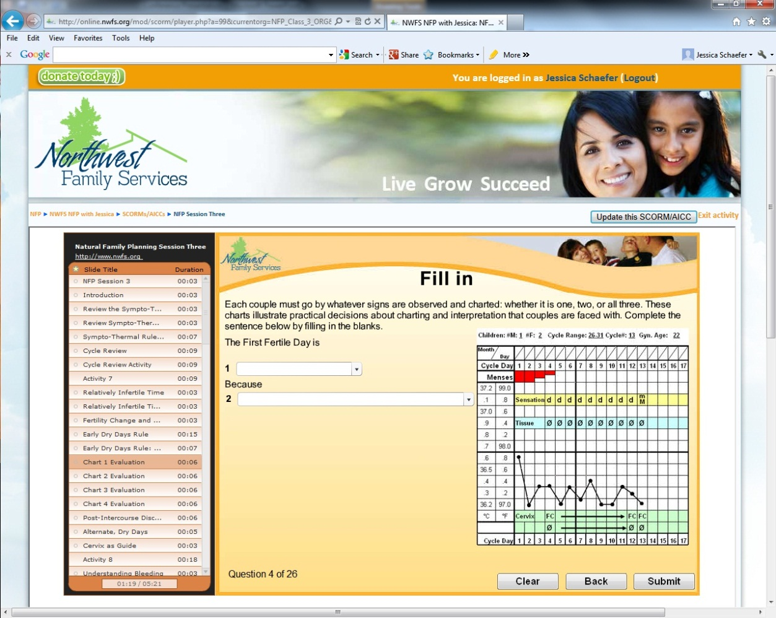
How is the content presented online?
Activities and quizzes built into each session
Notes:
The Learning Activities provide that opportunity to apply the information you have read to make certain that it is clear and that you are able to apply it.

Slide 11
Overview of our SymptoProTM Fertility Education E-Distance Learning Program
What is SymptoProTM Fertility Education
How content is presented
How tests are administered
Discussion of client autonomy and charting
Overview of our support to clients
Enrollment and fees
Partnership with NWFS

Slide 12
How tests and follow up is administered
Fertility history in take form at the end of Session One.
Follow up forms to assess the client’s understanding of content thus far at the end of Session Two and Three.
Review of personal charting at the end of each session.
Final Exam taken by clients online after the third session is complete.
Notes:
Fertility history is optional for clients uncomfortable sharing medical information.
Online learning facilitates this ongoing support for many clients who relocate or move throughout their reproductive lives.
Will discuss the final exam more in a moment.

Slide 13
Overview of our SymptoProTM Fertility Education E-Distance Learning Program
What is SymptoProTM Fertility Education
How content is presented
How tests are administered
Discussion of client autonomy and charting
Overview of our support to clients
Enrollment and fees
Partnership with NWFS

Slide 14
Client Autonomy and Charting
In order to receive a certificate of completion, clients are asked to chart from the moment they complete Session One through the end of the course.
Personal charts are reviewed at the end of each session and as needed in between.
Clients are instructed to submit charting for the first 4-6 cycles beyond completion of the course. We do not consider clients autonomous users until they have done this.
Ongoing chart review by a certified instructor is recommended for the first 6 months to a year after the completion of the course.

Slide 15
Two ways to chart
Paper chart submitted via scan, fax or physical mail
Online Charting App
Notes:
Next slides blows up the in take box

Slide 16
Online Charting App: Entering Observations
Notes:
Highlight different parts of the form. Encourages active application of the rules each day by asking was today fertile?

Slide 17
Online Charting App: Feedback and Review
Expandable feedback menu for instructor to record any communication and chart review with each cycle.
Notes:
Explain how chart review is requested and privacy rules.
Keeps record of all correspondence.

Slide 18
Online Charting App
The Online Charting App is specifically not designed for automatic interpretation
Each woman and each cycle may have many variations that would benefit from the trained eye of a certified SymptoPro™ Instructor.
Encourages clients to make active decisions about their cycles instead of placing their fertility in the hands of a “device” or program that may not be able to maintain our high effectiveness rates.
Allows instructor to see the client’s understanding of the rules as they apply them to their own chart.
Facilitates interaction between the client and instructors.
Notes:
Keeps record of all correspondence

Slide 19
Overview of our SymptoProTM Fertility Education E-Distance Learning Program
What is SymptoProTM Fertility Education
How content is presented
How tests are administered
Discussion of client autonomy and charting
Overview of our support to clients
Enrollment and fees
Partnership with NWFS

Slide 20
Supported offered for Online Clients
Instructor interaction through many modalities depending on the instructor and client preferences.
Email, phone or video conference online (Skype)
There is no additional charge for ongoing support and chart review for clients taking the course through NWFS no matter how long it’s been since taking the course.
Online sessions provide multiple links to click for more information and additional learning opportunities.
Trained approach for different client intentions.
Notes:
Online learning facilitates this ongoing support for many clients who relocate or move throughout their reproductive lives.

Slide 21
Different client intentions
For clients who intent to actively practice NFP after completing the introductory course:
Recommend chart review for 6 months to a year after completion of online instruction.
For clients who are still undecided if they will continue charting:
When they decide to practice NFP in the future we recommend contact for a refresher free of charge.
Articles of Interest page for more information on various topics related to the Catholic Faith and Fertility.
Notes:
We ask couples their intentions regarding NFP at the end of Session One.
Because various couples are at different points and places in their relationships and faiths, we have an articles of interest page

Slide 22
Different client intentions
We offer a specific approach for working with clients stating a strong opposition or discomfort with charting because of lack of interest in NFP or personal reasons:
Same course requirements, course length and content presented.
In place of the charting component and review we offer these couples to do an alternative reading and writing assignment to fulfill the requirement.

Slide 23
Alternative assignment in place of charting
Two article reflections in the place of chart review for grave opposition to charting:
One article can be selected from our pre-screened list of articles linked to the SymptoProTM website related to NFP, the risks of birth control, women’s health and reproduction as well as the Church’s teachings.
The second article is a specific article we choose for all couples called “Married Love and the Gift of Life.”
We have seen several fruits of the article reflections option so far:
They create an open dialogue and space to ask questions about NFP or the effects of contraception.
Many clients return deciding to chart after reading the articles anyway.
Decreased “copied” or fake charts and an improved, authentic relationship with clients.

Slide 24
Overview of our SymptoProTM Fertility Education E-Distance Learning Program
What is SymptoProTM Fertility Education
How content is presented
How tests are administered
Discussion of client autonomy and charting
Overview of our support to clients
Enrollment and fees
Partnership with NWFS

Slide 25
Enrollment and Course fees
Clients enroll in our online course directly through NWFS for marriage prep via SymptoPro.org where they will be taught by our group of certified online instructors
Course fee with free ebook is $110
Course fee with paper book is $135
Fee includes charting materials such as thermometer, paper charts, ebook or paper back guidebook, 4 months access to online course and use of charting app
Benefits:
Established NFP program with successful testimonies from clients and instructors.
Quick turnaround for receiving certificate after completion of the online course.
LIFETIME of support for clients at no additional charge!

Slide 26
Overview of our SymptoProTM Fertility Education E-Distance Learning Program
What is SymptoProTM Fertility Education
How content is presented
How tests are administered
Discussion of client autonomy and charting
Overview of our support to clients
Enrollment and fees
Partnership with NWFS

Slide 27
Partnership Opportunities
You can provide the ongoing support for local couples in either in person or online courses by partnering directly with NWFS and put money back into your program!

Slide 28
Partnership Opportunities
Your Diocese or NFP Office hires your local, certified in-person or online instructors to administer course to couples.
Instructors can be trained either locally through our various certified teacher trainers or online.
Clients will then pay fees directly to you to work with your local trained and certified instructors.
Notes:
Instructor training available online in English only whether they will teach in Spanish or English

Slide 29
A uniquely beneficial partnership to reinvest into your own program
Online: Certified SymptoPro instructors may also purchase a portal to our online program that allows them to customize the home page to reflect their unique program. There is a one-time set up fee of the customized portal of $525.
Online Course Fee: Once you have your own certified SymptoPro instructors we charge a base fee per couple that registers:
$50 with an ebook of manual
$75 for a paper copy of manual
Over and above this base price, you set the cost of the course, and recoup anything above the 50 or 75.
In-person Course Fee: $35 per couple to cover the cost of the packet they receive.
An average course is 100-130 dollars.
Notes:
$35 per client in person
$50 w ebook per client
$75 with paper copy
$110 is average price ppl charge for course

Slide 30
Overview of our SymptoProTM Fertility Education E-Distance Learning Program
What is SymptoProTM Fertility Education
How content is presented
How tests are administered
Discussion of client autonomy and charting
Overview of our support to clients
Enrollment and fees
Partnership with NWFS

Slide 31
SymptoProTM Fertility Education
May I answer your questions?

