Slide 1
Initial Preparation to Encounter Christ in the Sacrament of Penance & Reconciliation
A New Evangelization Perspective
Catechetical Sunday 2014, Catechist in-service

Slide 2
Prayer

Slide 3
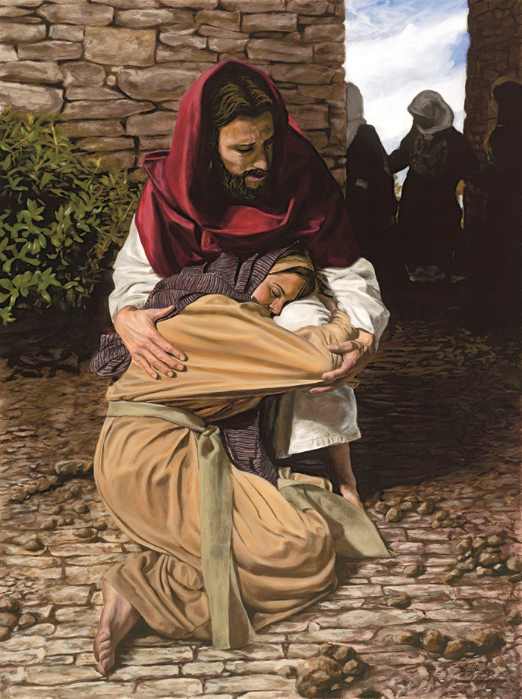
“The Sacrament of Penance and Reconciliation is the privileged place
to receive God’s mercy and forgiveness…
In this sacrament,
all the baptized have
a new and
personal encounter with Jesus Christ, …”
XIII Ordinary General Assembly of the Synod of Bishops,
Final Propositions, 2012, no. 33,
© Forgiving Sin by Jason Jenicke

Slide 4
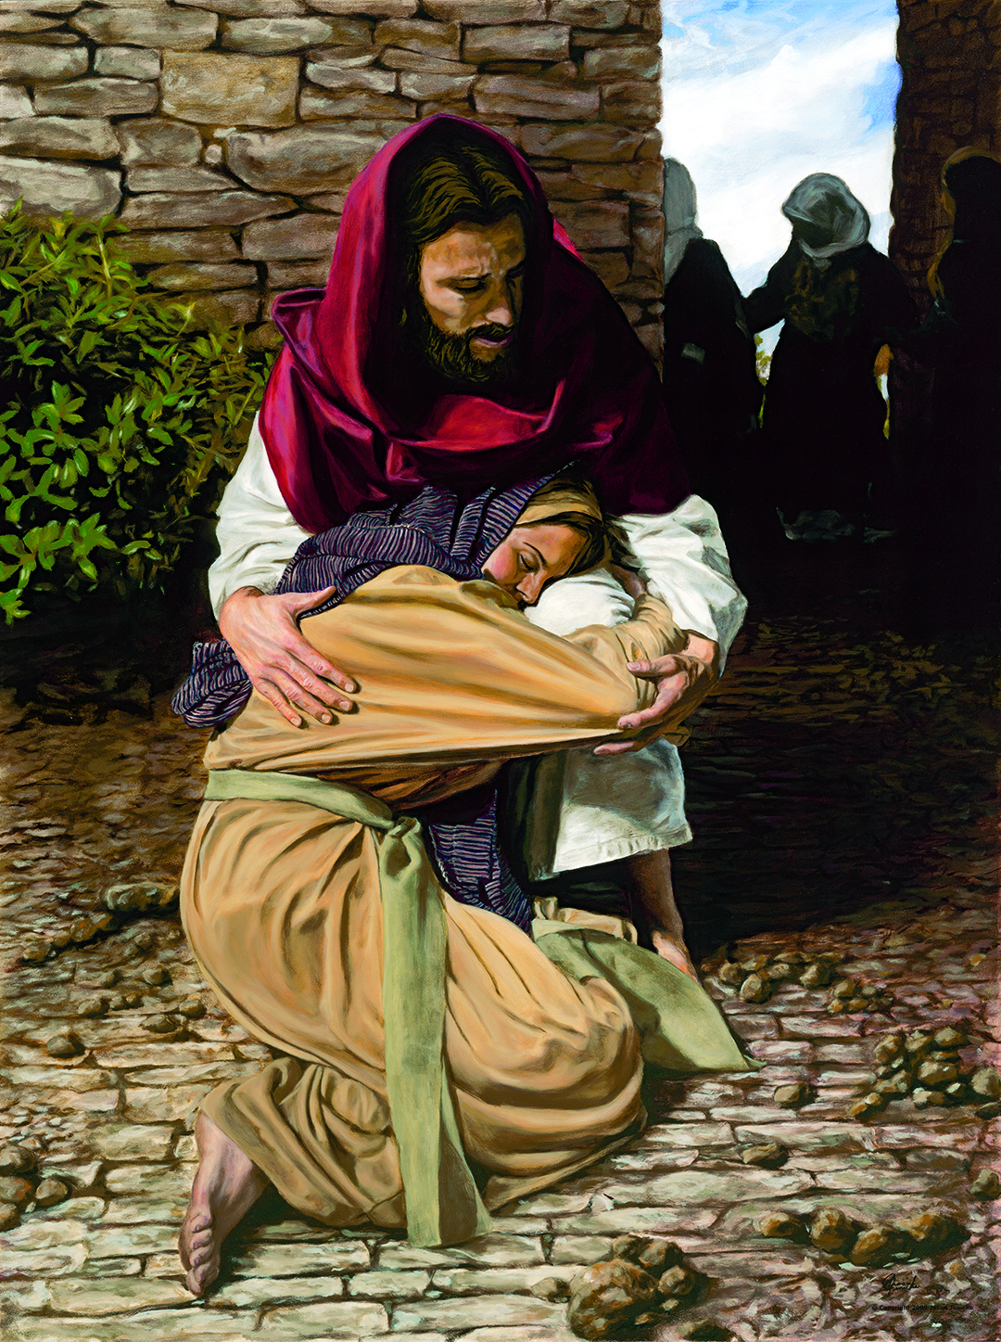
The Sacrament of Penance & Reconciliation…
…a new and personal encounter with Jesus Christ, …”

Slide 5
Objectives
Who is the catechist, and who is responsible for sacramental preparation?
A relationship in need of healing
Disposition to receive Penance and Reconciliation
Essential catechesis in preparation to receive Penance and Reconciliation

Slide 6
Sacramental Preparation
Who is a catechist, and who is responsible for sacramental preparation?
The entire Christian community
Bishop is chief catechist
Parents
Anyone who teaches the faith to children, youth, or adults
Lay catechists: volunteer or employed by Church
Clergy

Slide 7
A Relationship in Need of Healing
We are created in the image of the harmonious and just relationship within the Trinity.
Sin disrupted this state of “original justice.”
God continuously invites us to return to a right and just relationship.
God never tires of forgiving us; we are the ones who tire of seeking his mercy. (Evangelii Gaudium, no. 3)

Slide 8
A Relationship in Need of Healing
We are created in God’s image and likeness (Gn 1:26-27).
God is relational/God exists in relationship.
We are created to be IN relationship with God and with others.
We are created in the image of the harmonious and just relationship within the Trinity.

Slide 9
A Relationship in Need of Healing
Christ reconciled humanity with God and restored this just relationship.
Justification is the first act of reconciliation.
Christ reconciled us to the Father, made us partakers in his divine nature.

Slide 10
A Relationship in Need of Healing
Christ’s miracles during his public ministry were primarily healings that restored people to life in community.
Restoration to community restoration of relationship with God
Christ’s words and deeds anticipate the power of Paschal Mystery grace received through sacraments

Slide 11
A Relationship in Need of Healing
Christ’s miracles during his public ministry were primarily healings that restored people to life in community.
Power to forgive and reconcile belongs to God.
God’s love and mercy have primacy in this sacrament.

Slide 12
Disposition to Receive the Sacrament
The sacraments are efficacious signs of grace, instituted by Christ. . . . They bear fruit in those who receive them with the required dispositions. (Catechism of the Catholic Church [CCC], no. 1131)

Slide 13
Disposition to Receive the Sacrament
The sacraments are efficacious signs that effect the grace they signify—because it is CHRIST HIMSELF who is at work (ex opere operato) (CCC, nos. 1127-1128).
The fruitfulness of the sacraments also depends on the disposition of the person receiving the sacrament (CCC, nos. 1128, 1131).

Slide 14
Disposition to Receive the Sacrament
Is the concept of disposition new? Is this a new teaching? NO
Aquinas taught that, for those who receive Baptism as adults, the effects vary greatly; some receive greater grace than others according to their disposition.
(Summa Theologiae, Tertia Pars Q. 69 art.8)

Slide 15
Disposition to Receive the Sacrament
Believe in God’s grace, forgiveness, and mercy.
Be aware of the reality of sin.
Desire a conversion of heart.
Be willing to cooperate with God’s grace.

Slide 16
Disposition to Receive the Sacrament
The disposition of the penitent is expressed in these actions:
Examination of conscience Reflection from which realization of woundedness and need for healing, as well as a desire for conversion, follow
Contrition
Confession
Penance (satisfaction)

Slide 17
Essential Catechesis for This Sacrament
We try our best. We are diligent about giving the right preparation, right?
But . . . those whom we have prepared fail to practice the faith . . . Where are they months or years after receiving the sacraments?
Don’t get discouraged . . . but be careful!!! Let’s not lose sight of the forest because of the trees.

Slide 18
Essential Catechesis for This Sacrament
What is truly essential???
The goal of faith formation—including sacraments— is not simply accumulation of information, but rather formation of intentional disciples of Christ.

Slide 19
Essential Catechesis for This Sacrament
An intentional disciple of Christ
Desires to have a personal relationship with Christ
Is NOT formed in one or two school years
Embarks on a LIFELONG JOURNEY to deepen the relationship with Christ
Experiences CONVERSION and desires RESTORATION of the relationship with Christ when sin has occurred

Slide 20
Essential Catechesis for This Sacrament
Forming an intentional disciple of Christ . . .
Formation begins with hearing the Good News.
Evangelization occurs prior to catechesis.
Proclamation of the kerygma is essential.
Tell the story of God’s love and his invitation to a personal relationship with each one of us!!

Slide 21
Essential Catechesis for This Sacrament
Forming an intentional disciple of Christ . . .
Is NOT a new fad—it is DIVINE PEDAGOGY
Christ formed his first disciples by inviting them to follow him and revealing God’s love.
Matthew 4:18-19; Mark 1:16-17; Luke 5:27
Matthew 9:9; Mark 2:13-14
John 1:39

Slide 22
Essential Catechesis for this Sacrament
Forming an intentional disciple of Christ…
Information is received intellectually
However, this information will only
lead to transformation when
the HEART is open
to an ENCOUNTER with GOD

Slide 23
Essential Catechesis for This Sacrament
Essential catechesis for the Sacrament of Reconciliation . . . National Directory for Catechesis (NDC), p. 132
Acknowledgment of God’s faithful love
Acknowledgment of the existence of sin and the capacity to commit sin
Acknowledgment of God’s power to forgive sin and reconcile the sinner with himself and with the Church

Slide 24
Essential Catechesis for This Sacrament
Essential catechesis for the Sacrament of Reconciliation . . . NDC, pp. 132-136
God’s plan for holiness and salvation of all
God’s infinity love and mercy
Christ himself forgives—priest is minister. The priest is bound by the seal of confession (CCC, no. 1467).

Slide 25
Essential Catechesis for This Sacrament
Essential catechesis for the Sacrament of Reconciliation . . . NDC, pp. 132-136
Sin is turning away from God and not loving fully.
Ten Commandments teach us about loving God and others.
Mortal sins: serious matter, full knowledge, intentional and conscious consent (CCC, no. 1857).
Some factors diminish responsibility and culpability for an action (CCC, nos. 1735, 1860).

Slide 26
Essential Catechesis for This Sacrament
Essential catechesis for the Sacrament of Reconciliation . . . NDC, pp. 132-136
Centrality of desire for conversion and importance of disposition
Effects are healing, reconciliation, and restoration.
Explanation of symbols, gestures, and prayers
Be respectful of each person’s unique circumstances.
Involve parents of young children and adolescents.

Slide 27
Reflection for Catechists
Luke 18:35-43
What does this passage say about the blind man’s encounter with Christ?
What does Jesus ask in verse 41, and what does this tell you about the disposition of the man?
What else is significant to you in this passage?
How can this passage help you prepare others to encounter Christ in the Sacrament of Reconciliation?

Slide 28
Reflection for Catechists
Catechetical Sunday 2014, 25th Sunday in Ordinary Time, Year A
Isaiah 55:6-9; Psalm 145:2-3, 8-9, 17-18; Phil 1:20c-24, 27; Matthew 20:1-16
What is the central theme of these readings?
What connection do you notice between the First Reading and the Gospel?
What advice does Paul give concerning conduct, and how do you think this relates to discipleship?
How does the message of the Responsorial Psalm relate to the encounter with Christ in the Sacrament of Penance and Reconciliation?

Slide 29
Bibliography
Aquinas, Thomas. "Third Part, Question 69. The effects of Baptism." New Advent - The Summa Theologica of St. Thomas Aquinas - literally translated by Fathers of the English Dominican Province. 1920 (second and revised edition) - 2008 online edition (by Kevin Knight). http://www.newadvent.org/summa/4069.htm (accessed January 4, 2014).
Catechism of the Catholic Church. 2nd ed. Vatican City: Libreria Editrice Vaticana, 1997.
Congregation for the Clergy. General Directory for Catechesis. Washington DC: USCCB Publishing, 1998.
Francis, Pope. "Post-Synodal Apostolic Exhortation Evangelii Gaudium [Joy of the Gospel]." Vatican. November 24, 2013. http://www.vatican.va/holy_father/francesco/apost_exhortations/documents/papa-francesco_esortazione-ap_20131124_evangelii-gaudium_en.html (accessed January 5, 2014).
USCCB Committee on Education and Committee on Catechesis. National Directory for Catechesis. Washington DC: USCCB Publishing, 2005.
Vatican Council II. "Decree Presbyterorum Ordinis [Decree on the Ministry and Life of Priests], promulgated by Pope Paul VI,." Vatican. December 7, 1965. http://www.vatican.va/archive/hist_councils/ii_vatican_council/documents/vat-ii_decree_19651207_presbyterorum-ordinis_en.html (accessed December 22, 2013).
XIII Ordinary General Assembly of the Synod of Bishops. "Final Propositions." Vatican. October 27, 2012. http://www.vatican.va/news_services/press/sinodo/documents/bollettino_25_xiii-ordinaria-2012/02_inglese/b33_02.html (accessed December 20, 2013).
Art Credit
© Forgiving Sin (A Prodigal Daughter) by Jason Jenicke @ www.jasonjenicke.com. Used with permission.

